Slide 1
◌
Real-Time Human Activity
Recognition
from Smartphone Sensors · Fourier+Transformer
CRISP-DM Final Report (HW4) · Evaluation & Deployment
Almog Tal · Daniel Korkevados · Lior Sulshtein · Ilay Damari
Ben-Gurion University · Introduction to Data Science in Industry
Notes:
Opening. Do not start with code. Tell the audience this is a workshop-style presentation with notebook checkpoints throughout.

Slide 2
WORKSHOP DESIGN
02
Presentation contract: workshop, not slide dump
PPT
No code pasted into slides
NB
Notebook appears early
DEMO
Live demo has fallback
Slides explain concepts and results. Implementation is shown inside the executed notebook.
We switch into HAR_HW4_display.ipynb during the EDA section, then return to slides.
RunPod live service is primary; sample windows keep the workshop working if connectivity fails.
01
02
03
04
05
Raw window
Time branch
FFT branch
Late fusion
Classifier
128×9
128 tokens
65 bins
CLS + CLS
6 classes
Rhythm: 6–8 slides → notebook output → 5–6 slides → notebook output → deployment demo
›
This directly avoids presenting the full deck first and code only at the end.
›
The notebook is part of the narrative: EDA, model, results and inference.
Presenter instruction: keep this slide short; use it as the contract for the session.
Notes:
Mention this structure explicitly at the beginning. It addresses the grading feedback without sounding defensive.

Slide 3
QUALITY CHECKLIST
03
Built around the lecturer feedback
Risk
Deck response
Where it appears
Bad slides/code integration
Interleaved notebook checkpoints
Slides 9, 18, 23, 29
No notebooks
Notebook named and used live
HAR_HW4_display.ipynb
Slides first, code after
Workshop rhythm from slide 2
Throughout
EDA too thin
Rich EDA: windows, subjects, energy, FFT, gravity, PCA, correlation
Part 1
Unreadable code
Code stays in helper modules, not pasted onto PPT
Notebook + files
Demo not ready
RunPod + local sample fallback
Part 4
Design principle:
Slides tell the story. The notebook proves it. The demo closes it.
Notes:
Use this as a fast A++ checklist.

Slide 4
Part 1: Motivation & Data
Presented by Almog Tal

Slide 5
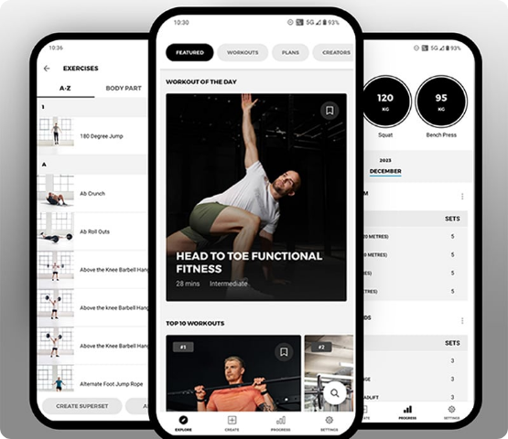
PART 1 · MOTIVATION
05
Smartphone activity recognition without extra hardware
0
50 Hz
2.56 s
extra devices
sensor stream
window
›
**Unobtrusive monitoring** without cameras or external wearables.
›
**Privacy-friendly signal** for context-aware health applications.
›
**Real challenge:** generalization to completely unseen people.
Objective: raw phone stream → activity label in near real time
Smartphone sensors are already present
Notes:
Open with business value and privacy.

Slide 6
PART 1 · RESEARCH QUESTIONS
06
Three research questions drive the project
M1
Transformer efficacy
FFT
Frequency impact
S9
Sensor relevance
Can a Transformer label six activities from only 2.56 s of raw 9-channel signal?
Does adding FFT information improve predictions over raw time signal alone?
Which smartphone channels are actually required for accurate classification?
Every later result answers one of these questions: model comparison, architecture ablation and sensor ablation.
Notes:
Tie each question to an experiment: transformer family, FFT branch, sensor ablation.

Slide 7
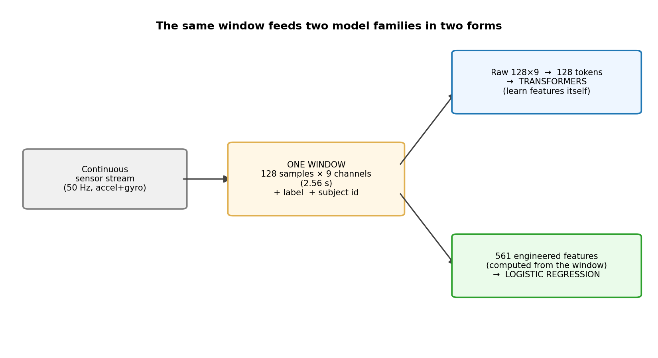
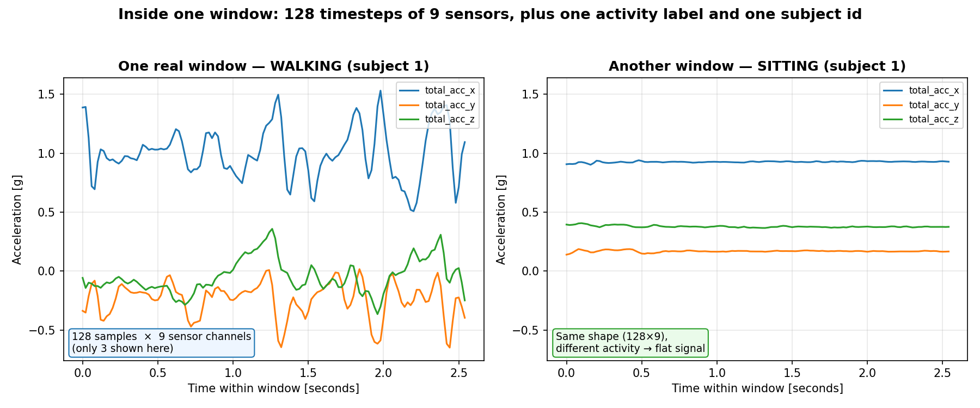
PART 1 · DATA
07
Dataset: UCI HAR, 30 subjects, six activities
10,299
30
128×9
21 / 9
6
total windows
volunteers
window shape
train / test subjects
activity classes
One window: 128 timesteps × 9 channels + label + subject id
Same window supports raw-signal Transformers and engineered baselines
Labels: WALKING, WALKING_UPSTAIRS, WALKING_DOWNSTAIRS, SITTING, STANDING, LAYING
Notes:
Explain units and split. The model receives raw inertial windows; the classical baseline receives engineered features.

Slide 8
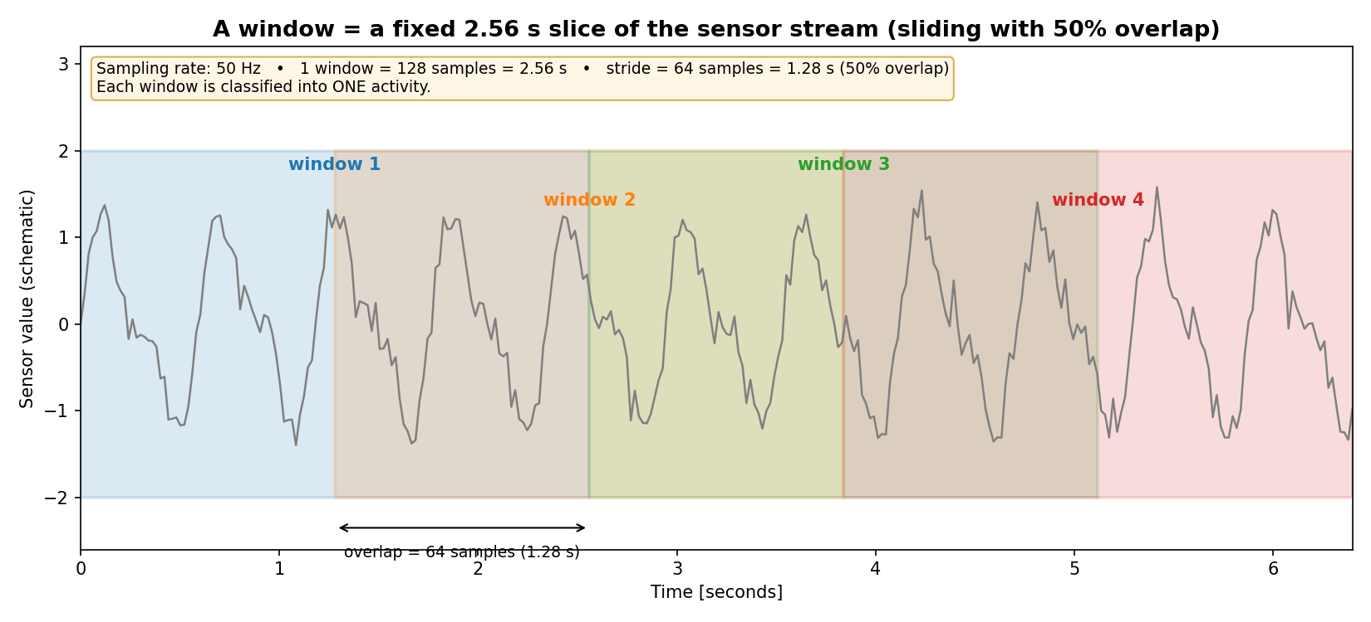
PART 1 · DATA PIPELINE
08
A window is a fixed 2.56 second slice of the stream
50 Hz sampling · 128 samples · stride 64 samples · 50% overlap
›
Each window is classified into exactly one activity.
›
The official dataset uses overlap, so subject-disjoint splitting is essential.
Notes:
Use this slide to make the 128-sample window intuitive.

Slide 9
LIVE NOTEBOOK
09
Notebook checkpoint 1: EDA outputs, not pasted code
LIVE NOTEBOOK CHECKPOINT
HAR_HW4_display.ipynb · Section 2
Show executed EDA cells: class balance, windows per subject, raw signals, FFT and PCA
This prevents a slide-only presentation and proves the EDA live without pasting code into the deck.
Return to slide 10 after the EDA outputs.
Notes:
Switch to the pre-executed notebook now. Show section 2: loading data, class distribution, raw windows and spectra. Do not scroll through code line-by-line; show outputs.

Slide 10
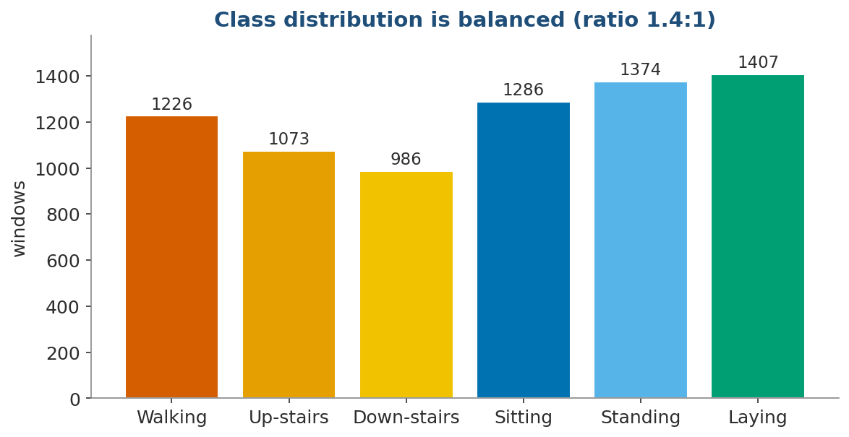
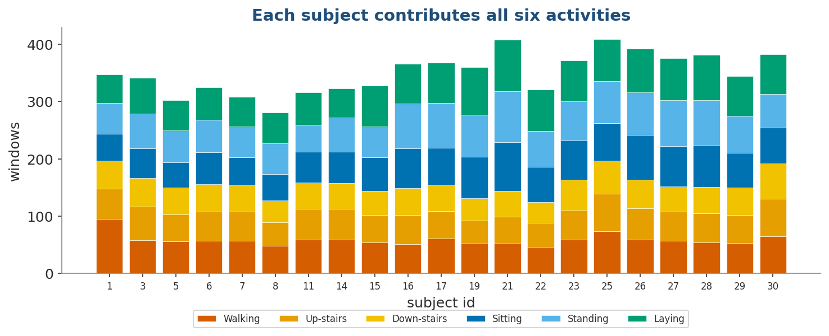
PART 1 · EDA
10
EDA 1: the data is balanced and subject-covered
Class ratio is balanced enough for macro-F1
Each training subject contributes all six activities
›
Macro-F1 is appropriate because all six classes should matter equally.
›
Subject coverage supports subject-wise validation and ablations.
Notes:
Show that class imbalance is not the main issue; generalization is.

Slide 11
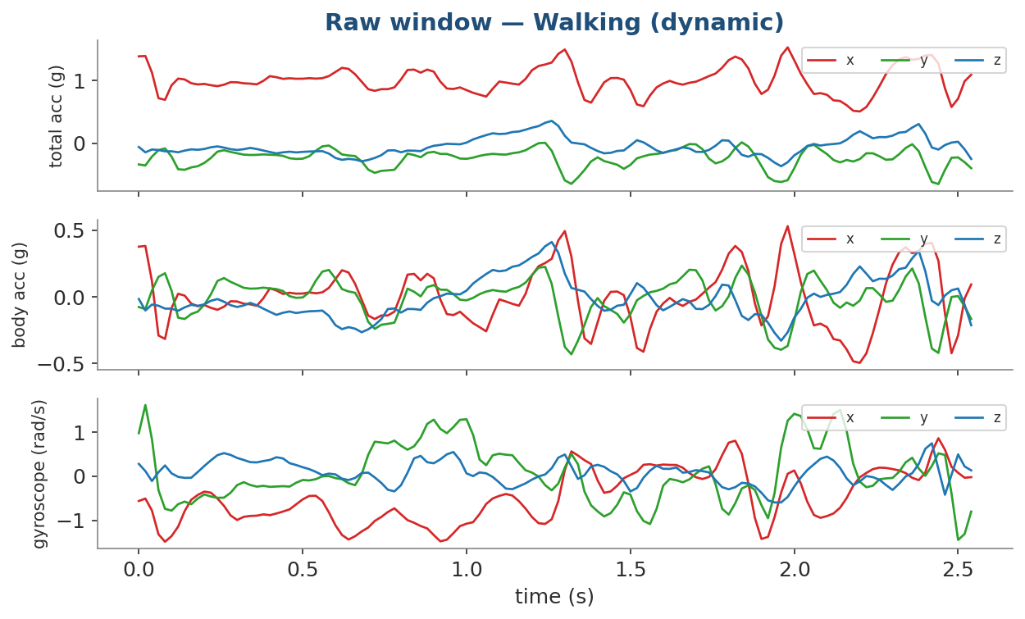
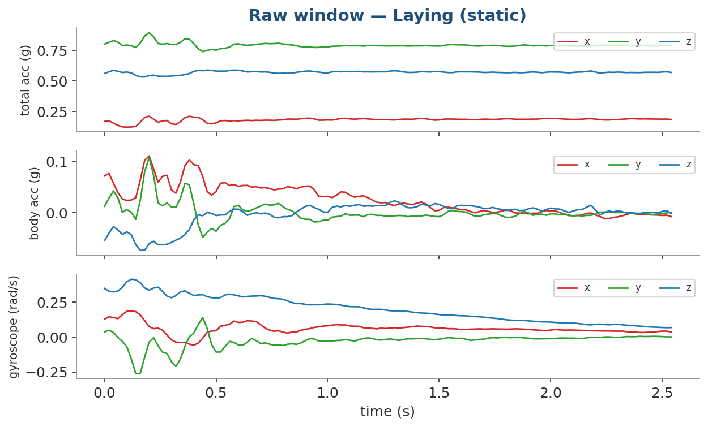
PART 1 · EDA
11
EDA 2: dynamic and static windows look fundamentally different
Walking: oscillatory multi-axis movement
Laying: mostly flat signal with gravity orientation
Notes:
Use the raw window plots to give intuition before the statistics.

Slide 12
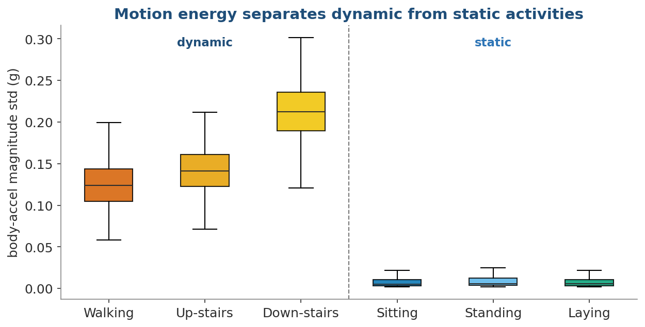
PART 1 · EDA
12
EDA 3: motion energy separates dynamic from static
E
Dynamic cluster
Walking, upstairs and downstairs have high within-window motion energy.
S
Static cluster
Sitting, standing and laying are near-flat with tiny body-acceleration variation.
✓
Impact on errors
The deployed model shows essentially zero dynamic ↔ static mistakes.
Body-acceleration magnitude standard deviation
Notes:
This is one of the central insights; connect it to zero dynamic/static confusion later.

Slide 13
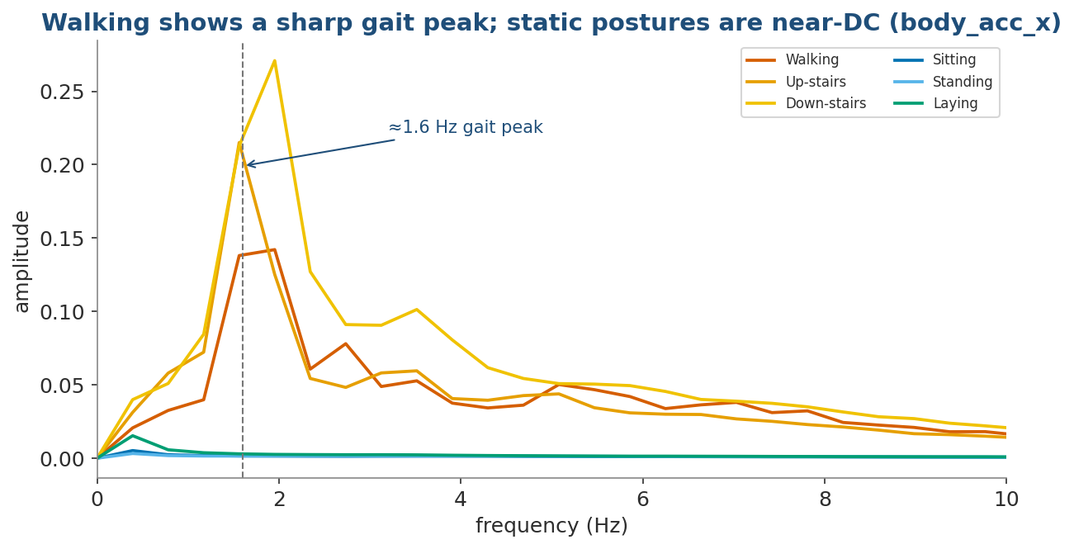
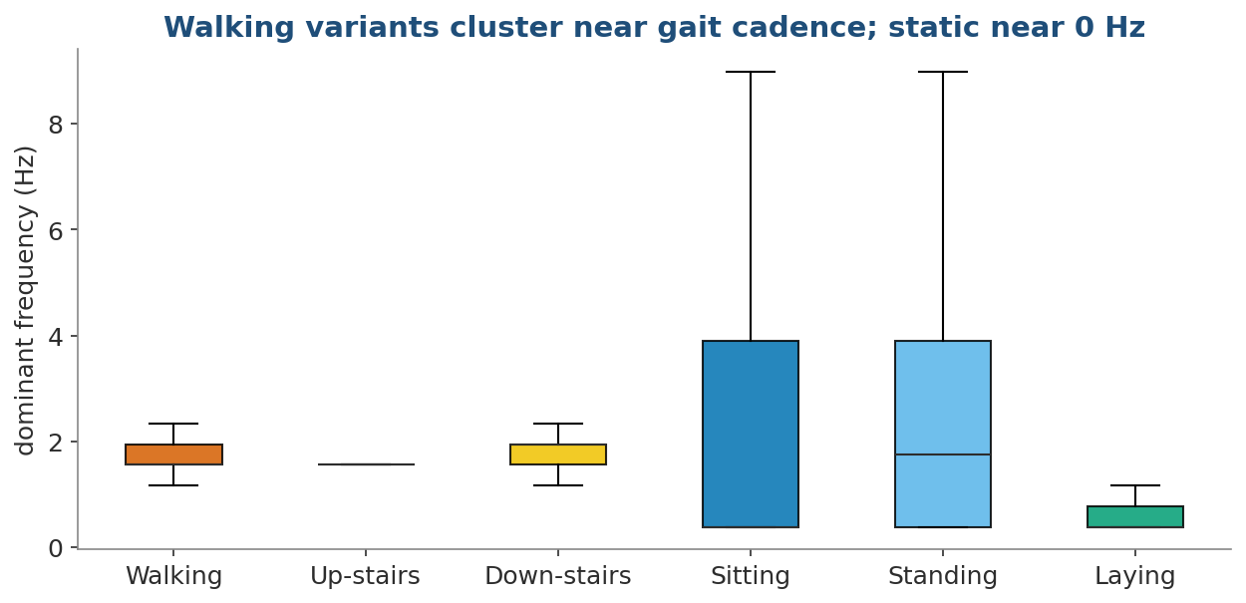
PART 1 · EDA
13
EDA 4: walking has a gait peak; static postures are near-DC
Mean amplitude spectrum: walking variants show a gait peak
Dominant frequency: walking clusters near cadence
Key signal: ~1.6 Hz cadence
Key modeling implication: frequency domain is not optional.
Notes:
This slide motivates the Fourier branch.

Slide 14
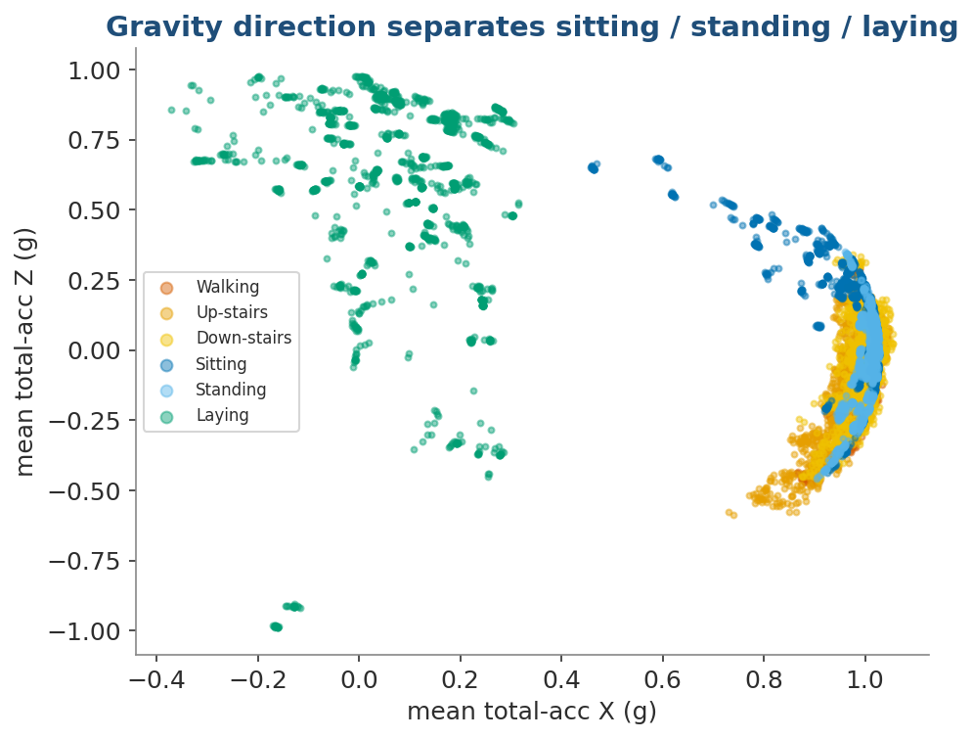
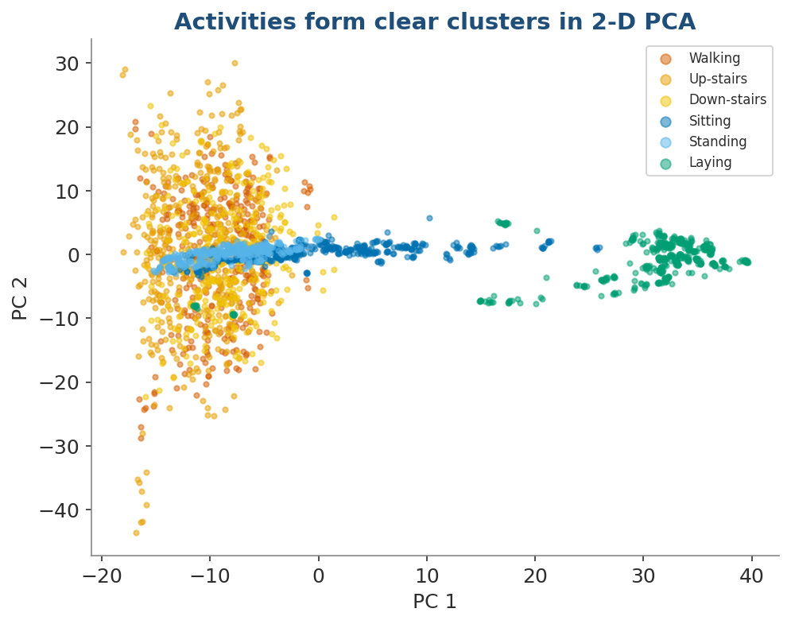
PART 1 · EDA
14
EDA 5: gravity direction explains the static posture challenge
Mean total-acc X/Z separates sitting, standing and laying
PCA shows structured clusters in raw 128×9 space
Static postures are hard because they are near-DC but differ by gravity orientation.
Notes:
Explain FFT bin 0/DC without equations: mean acceleration per axis carries orientation.

Slide 15
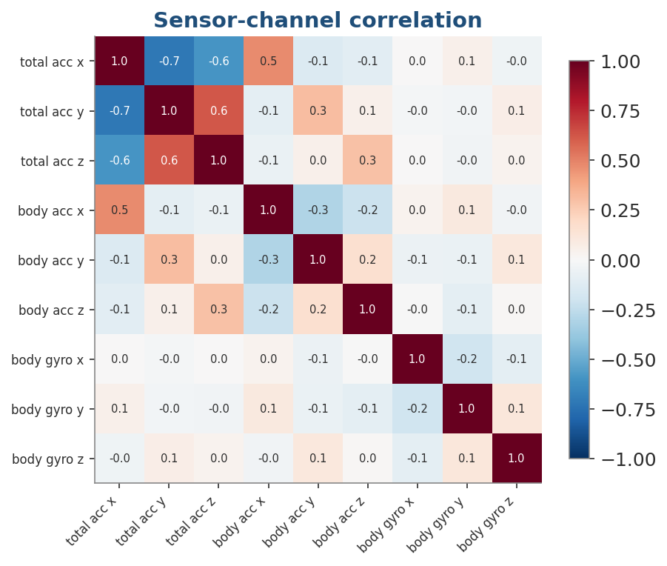
PART 1 · EDA
15
EDA 6: accelerometer and gyroscope are complementary
ACC
Acceleration channels
Total acceleration captures both motion and gravity orientation.
GYR
Gyroscope channels
Low correlation with acceleration: complementary, but weak alone.
ABL
Experiment design
Sensor ablation tests each modality instead of guessing.
Channel correlation across all timesteps
Notes:
Use this to motivate sensor ablation.

Slide 16
Part 2: Methodology & Models
Presented by Daniel Korkevados

Slide 17
PART 2 · MODELS
17
Modeling strategy: compare strong baselines to raw-signal deep models
CL
Classical baseline
561 UCI engineered features → Logistic Regression / SVM / RF.
DL
Raw deep learning
128×9 raw windows → Main Transformer / Patch / CNN / Fourier+Transformer.
OK
Fair conclusion
The deployed deep model nearly matches the best engineered-feature baseline.
Same 2.56 s window, two modeling families
Important caveat: engineered features remain slightly ahead in absolute F1, but require manual feature design.
Notes:
This is the fairness slide: classical baselines are strong and must be respected.

Slide 18
LIVE NOTEBOOK
18
Notebook checkpoint 2: architecture and readable modules
LIVE NOTEBOOK CHECKPOINT
HAR_HW4_display.ipynb · Section 3
Show the FourierTransformer module and helper file structure
The code is readable because plotting, data loading and model loading live in separate helper modules.
Return to slide 19 after showing the architecture cell briefly.
Notes:
Open Section 3. Show the architecture cell and the helper modules list. Do not paste code in slides. Explain where the code lives and why it is readable.

Slide 19
PART 2 · FINAL MODEL
19
Fourier+Transformer: two branches, one prediction
01
02
03
04
05
Raw window
Time branch
FFT branch
Late fusion
Classifier
128×9
128 tokens
65 bins
CLS + CLS
6 classes
T
Time branch
F
Frequency branch
L
Late fusion
Self-attention over the raw temporal sequence learns gait phase and local dynamics.
Self-attention over FFT magnitude bins captures cadence and DC gravity signature.
The two CLS representations are concatenated, then classified into six activities.
Design intuition: time answers “how does it move?”; frequency answers “what rhythms and orientation are present?”
Notes:
Explain the design with no code. Emphasize time branch + frequency branch + late fusion.

Slide 20
PART 2 · EVALUATION
20
Evaluation is subject-disjoint and macro-F1 driven
S
Subject-disjoint split
F1
Macro-F1 metric
T
True test split
All windows from a person stay together. Train subjects are not test subjects.
Each activity contributes equally, so minority activities cannot be ignored.
The official 9-subject test split is held out for final evaluation.
Train
Validation
Test
21 subjects
held-out train subjects
9 unseen subjects
Why it matters: random window splits would overestimate performance because adjacent windows overlap.
Notes:
This earns credibility. Mention test set touched once.

Slide 21
PART 2 · ABLATION
21
Architecture ablation: small, patched and positional wins
A5 patch-8 + sinusoidal + CLS
0.937
P8
Patching helps
A3 learnable PE + mean
0.925
Patch-8 tokens beat per-timestep tokens by aggregating local signal.
A7 more heads
0.923
PE
Position matters
A4 sinusoidal + CLS
0.921
Removing positional encoding is the weakest configuration.
A6 4 layers
0.916
2L
Bigger is not better
A2 sinusoidal + mean
0.913
Four layers underperform two layers on this small dataset.
A1 no PE + mean
0.897
Best validation config: A5 patch-8 + sinusoidal PE + CLS pooling
Notes:
Explain validation-only ablation results.

Slide 22
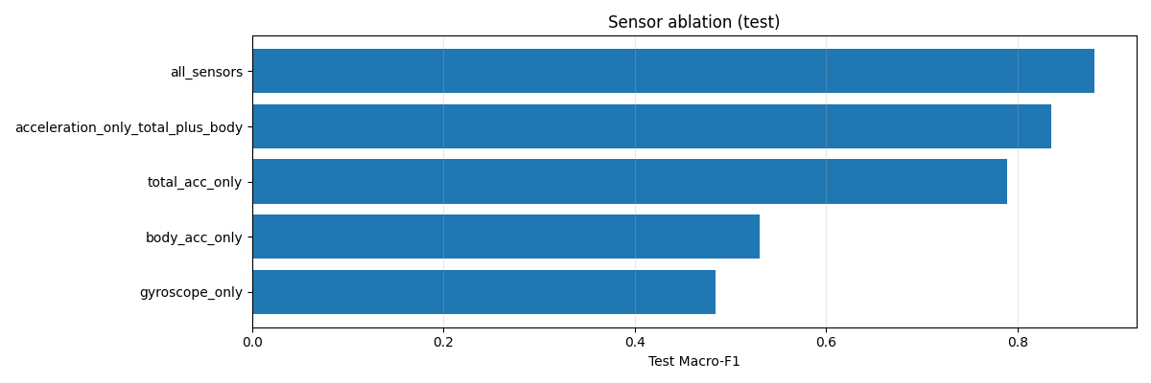
PART 2 · ABLATION
22
Sensor ablation: acceleration carries the signal, all sensors win
All 9 sensors
0.881
Acceleration only
0.836
Total acceleration only
0.789
Body acceleration only
0.530
Original notebook figure
Gyroscope only
0.484
TA
Total acceleration core
GY
Gyro alone weak
9
Deploy all 9 channels
Contains both movement and gravity orientation.
Near-chance F1, but complementary in all-sensor model.
Final service requires accel + gyro stream.
Notes:
Tie this back to the correlation slide and to deployment requirements.

Slide 23
LIVE NOTEBOOK
23
Notebook checkpoint 3: results, reports and confusion matrix
LIVE NOTEBOOK CHECKPOINT
HAR_HW4_display.ipynb · Results section
Show model comparison, test report and confusion matrix outputs
The audience sees the exact executed metrics, not a hand-copied result table only.
Return to slide 24 after the classification report.
Notes:
Open results section. Show final comparison, classification report, confusion matrix. This replaces static code with live evidence.

Slide 24
PART 3 · RESULTS
24
Results: Fourier+Transformer is the best deployed raw-signal model
Fourier+Transformer
0.948
★
Best deployed model
LogReg · 561 features
0.956
Fourier+Transformer with augmentation reaches 94.8% accuracy / 94.77% macro-F1.
Patch Transformer
0.899
!
Honest caveat
CNN-Transformer
0.896
LogReg with 561 engineered features is still slightly higher at ~95.6% F1.
Main Transformer
0.882
LogReg · 6 features
0.785
→
Why it matters
The deep model learns from raw sensors and is easier to adapt/deploy end-to-end.
Gyroscope only
0.484
Takeaway: classical baselines are strong; the deep model closes the gap without manual feature engineering.
Notes:
Be precise: engineered Logistic Regression has the top classical score; deployed deep model is near-SOTA and end-to-end.

Slide 25
PART 3 · RESULTS
25
Error analysis: dynamic vs static separation is essentially perfect
True / Pred
Walking group
Sitting
Standing
Laying
0
Zero block confusion
Walking variants are not confused with static postures.
Walking group
1303
0
0
0
Sitting
0
456
33
2
DC
Remaining error
Most mistakes are Sitting ↔ Standing, both near-DC.
Standing
0
21
509
2
Laying
0
2
0
535
G
Laying solved
Laying is almost perfect because gravity orientation is distinct.
The confusion matrix matches the EDA: energy separates groups; gravity orientation separates postures.
Notes:
Use the simplified confusion table to explain the remaining error mode.

Slide 26
PART 3 · INTERPRETATION
26
Why Fourier+Transformer works
T
Time branch
F
Frequency branch
L
Late fusion
Learns temporal dynamics, gait phase and local motion patterns from the raw sequence.
Captures gait cadence and low-frequency/DC gravity signature.
Combines complementary evidence instead of forcing one representation to do everything.
FFT explains dynamic activity
Gravity explains static posture
EDA did not just describe the data; it directly shaped the model architecture.
Notes:
This is the conceptual payoff: EDA → architecture → result.

Slide 27
Part 3: Deployment & Demo
Presented by Ilay Damari

Slide 28
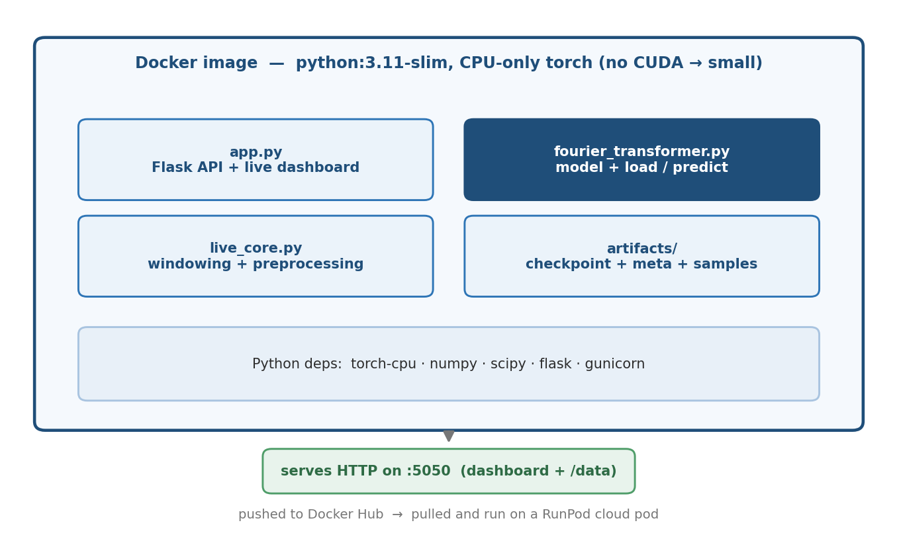
PART 3 · DEPLOYMENT
28
Deployment: self-contained Docker image on RunPod
IMG
Self-contained
Flask API, model loading, preprocessing and checkpoint live together.
☁
Cloud execution
Docker Hub image is pulled and executed on a RunPod instance.
API
HTTP interface
Port 5050 serves dashboard, /data ingestion and /state polling.
Container bundles API, model, preprocessing and artifacts
Notes:
Explain packaging, not code.

Slide 29
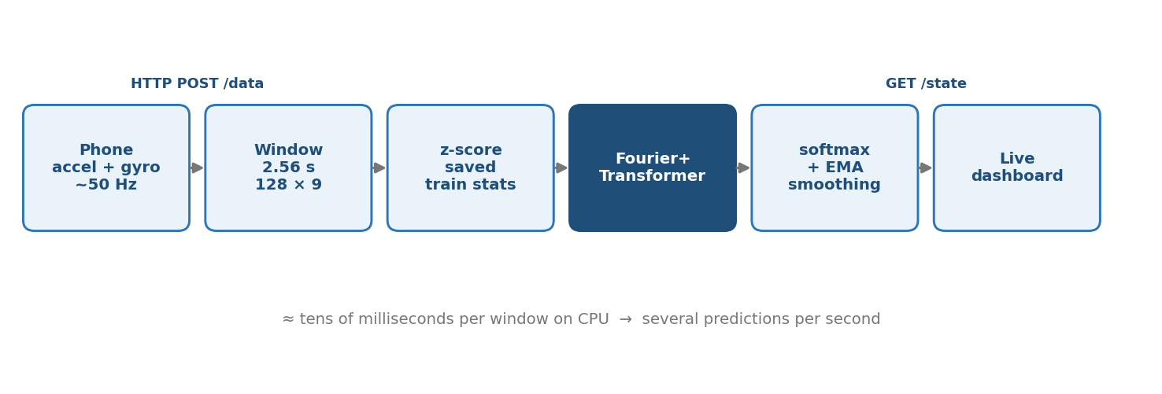
PART 3 · DEPLOYMENT
29
Real-time inference pipeline: phone stream to dashboard
Live request → preprocessing → model → smoothed dashboard prediction
›
Phone HTTP-POSTs accelerometer + gyroscope at about 50 Hz to /data.
›
Server buffers the last 2.56 seconds, resamples, computes body acceleration and applies saved train stats.
›
Model returns six probabilities; dashboard uses EMA smoothing for a stable live demo.
Notes:
Keep this operational. This is the workshop/demo flow.

Slide 30
LIVE NOTEBOOK
30
Notebook checkpoint 4: inference smoke test and demo fallback
LIVE NOTEBOOK CHECKPOINT
HAR_HW4_display.ipynb · Live inference section
Run or show the pre-executed sample-window inference output
This proves the workshop can finish on time even if RunPod/network is unavailable.
Then open the live dashboard URL if available.
Notes:
Open the notebook live inference section. Show sample_windows prediction or the fallback output. Then move to the live browser demo if available.

Slide 31
PART 3 · DEMO
31
Live demo plan: primary path plus fallback
01
Phone
02
RunPod
03
Model
04
Dashboard
Sensor Logger streams accel + gyro.
Public HTTPS service on :5050.
Fourier+Transformer predicts live.
Browser shows activity state.
Fallback: use sample_windows.npy inside the notebook to run the same model locally if live cloud connectivity fails.
Notes:
This directly addresses the “cluster did not work” feedback.

Slide 32
PART 3 · DEPLOYMENT
32
Monitoring risk: cross-device orientation shift
R
Main risk
M
Monitor
N
Retrain
A new phone position changes which axis gravity falls on.
Track confidence, calibration and sudden prediction drift in the live stream.
Collect in-the-wild data from more users and devices.
›
Future model work: Conformer / TCN / self-supervised pretraining.
›
Deployment work: quantization, distillation and on-device inference.
›
Dataset work: cross-dataset evaluation and transition detection.
Honest limitation: UCI HAR is controlled and waist-mounted; real phones introduce placement shift.
Notes:
Keep honest limitations and next steps.

Slide 33
CONCLUSION
33
Conclusion: research-quality evaluation, deployable prototype
1
Transformers work
2
Frequency matters
3
System deploys
Fourier+Transformer reaches 94.8% accuracy / 94.77% macro-F1 on unseen subjects.
FFT branch explains gait cadence and reduces static posture ambiguity.
Docker + Flask + RunPod provide a real-time CPU inference demo.
The project story is closed-loop: EDA → architecture → ablation → deployment → live demo.
Code and notebook reproduce the figures and results; slides are the narrative layer.
Notes:
End with three concrete claims.

Slide 34
Questions?
Thank you for your time and attention.
Almog · Daniel · Lior · Ilay

Slide 35
BACKUP
35
Backup: references and files
D
Dataset
T
Transformer
C
Process
Anguita et al. (2013), UCI HAR Dataset.
Vaswani et al. (2017), Attention Is All You Need.
CRISP-DM evaluation and deployment structure.
Artifact
Role
Presenter use
HAR_HW4_display.ipynb
Pre-executed notebook
Open during checkpoints
fourier_transformer.py
Model loader / inference
Show module only if asked
metrics.json
All experiment results
Source of plots/tables
live_demo_app
Flask + Docker service
Demo infrastructure
Notes:
Use only if asked.

